Slide 1
Objectives
A complete configuration of Eclipse for Windchill developments
Download and install eclipse
Configure project for development
Configure windchill jars
Configure File Sync
Configure decompiler
Prerequisites:
User should have windchill jars which needs to be imported

Slide 2
Download Eclipse
Navigate to sparsh
http://sparshv2/portals/CCD/Downloads/Pages/Downloads.aspx
Download the required eclipse by searching eclipse ide for java in search box on the right hand side.
Extract the downloaded zip file.
This is a plug and play program so we do not need to install the application. Just double click on eclipse.exe placed inside the extracted folder
Select an appropriate directory to work with

Slide 3
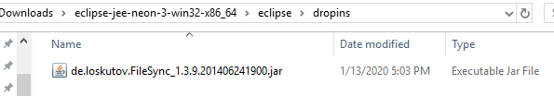
Install plugin
We need to install FileSync. This enables us to sync windchill codebase by creating a package inside codebase where the class files will directly get saved without compiling it manually.
Add attached jar inside dropins folder of eclipse.
Directory: eclipse-jee-neon-3-win32-x86_64\eclipse\dropins

Slide 4
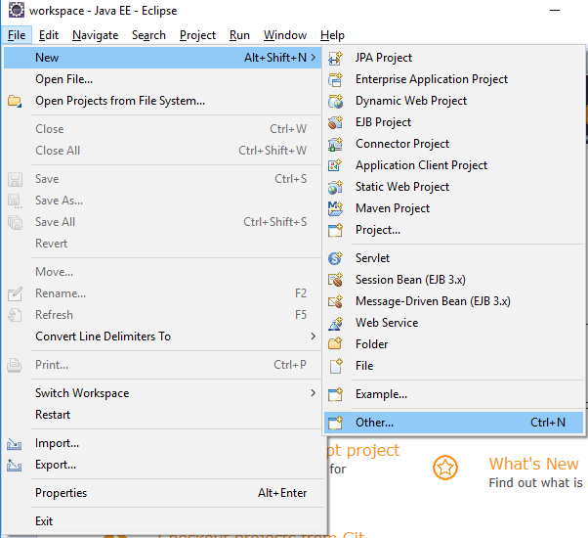
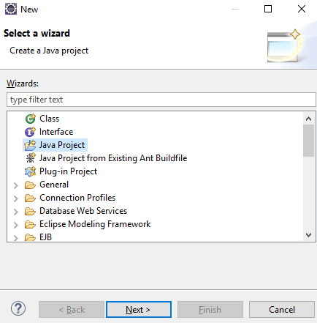
Create a Java Project
Open Eclipse and create a new java project as shown

Slide 5
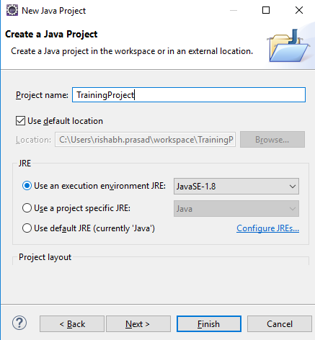
Enter Required Project Name.
Click on Next & Finish

Slide 6
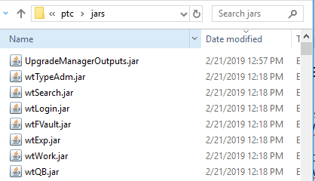
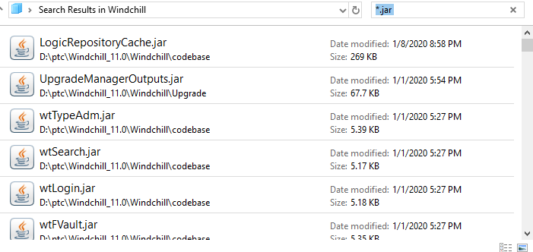
Copying jars to a location
Navigate to Windchill installation folder (D:\ptc\Windchill_11.0\Windchill) and search *.jar in search bar.
Copy all the jars to a location. This method ensures that we do not miss any jar present in windchill.

Slide 7
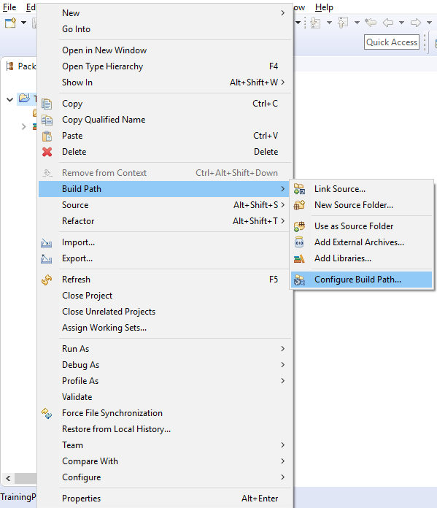
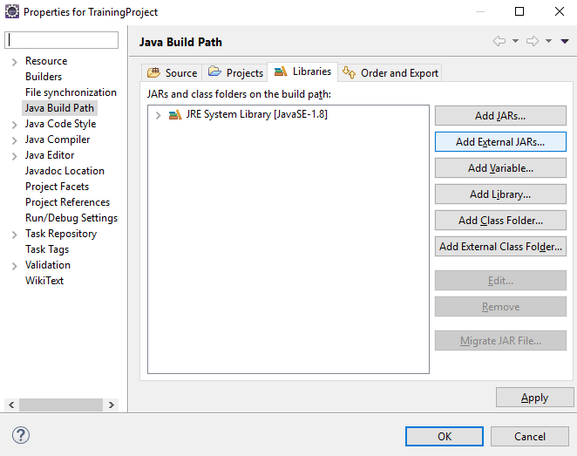
Set Environment for project
We need to configure Classpath which makes APIs available
Right Click on Created java project -> Select “Build Path” -> Configure Build Path -> Libraries -> Add External Jars.

Slide 8
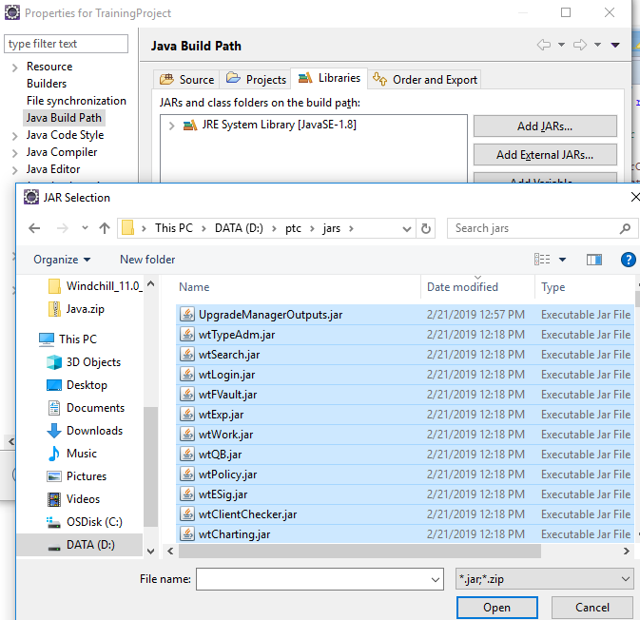
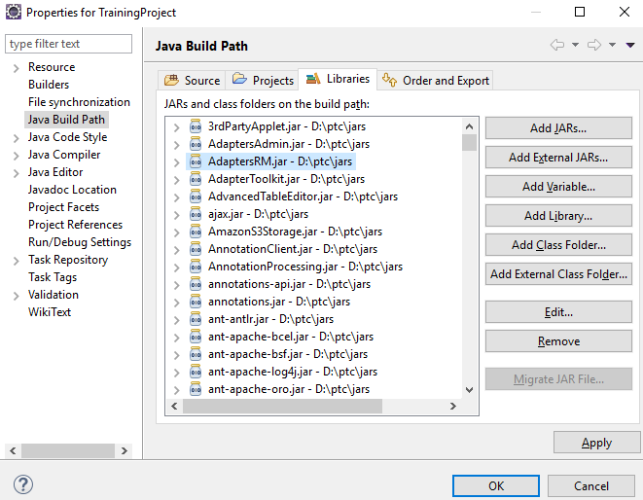
Navigate to the folder where you have added all the jars and add all the jars.
Under Window > Preferences> select Java > Compiler > Building > Output folder > Check Scrub output folders when cleaning projects.

Slide 9
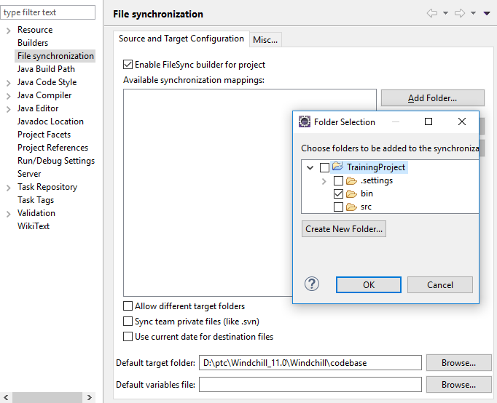
Set For File Sync
Right Click on Project -> Properties -> File Synchronization
This configuration will be effect when you created new modeling within annotation, system will synchronize automatically to Windchill.
Set “Enable FileSync build for project”
Click Add Folder
Select Bin folder under TrainingProject
Set “Default target folder” as Windchill codebase location.

Slide 10
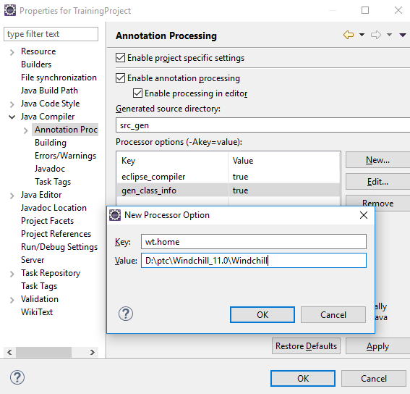
Annotation Processing
For annotation compiling, you must set following environment.
Set annotation configuration
• Goto Project properties > Java Compiler > Annotation Processing
• Set “Enable project specific setting”
• Set “Enable annotation processing”
• Set “Enable processing In editor”
• Change Generated source directory – “src_gen”
• Set 3 keys
eclipse_compiler=true
gen_class_info=true
wt.home=$WT_HOME

Slide 11
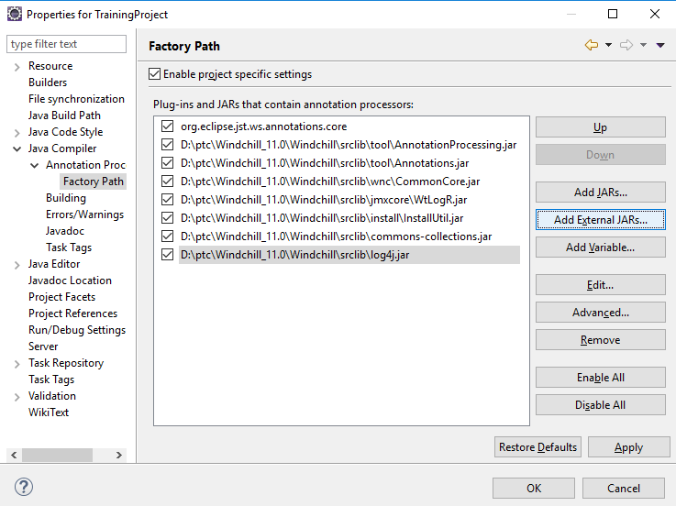
Set Factory path
Goto Project properties > Java Compiler > Annotation Processing > Factory Path
Add JARs files as per screenshot

Slide 12
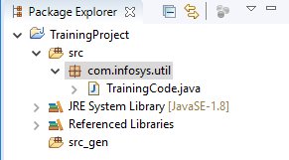
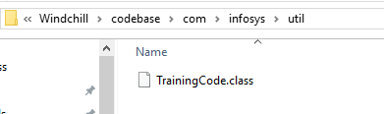
Testing FileSync
Create a package with any name. Here we have created com.Infosys.util. Then create a java class.
A folder with name Infosys/util should be created inside codebase/com and you can see the class file present at the location

Slide 13
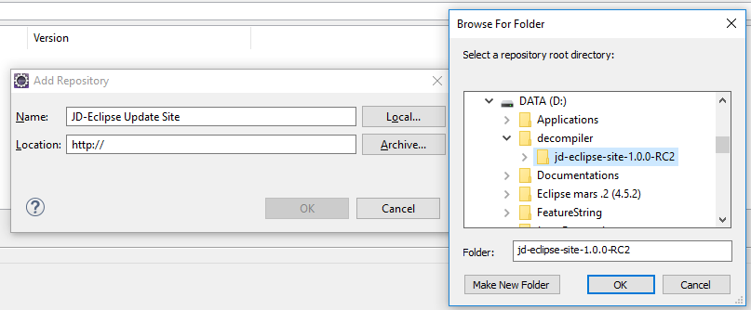
Configuring Decompiler
Keep the attached jar in a folder
Click on "Help > Install New Software..."
Click on button "Add...“ to add an new repository,
Enter "JD-Eclipse Update Site“ and select the local site directory,
Check "Java Decompiler Eclipse Plug-in",
Click Next, next, Accept the agreement, Finish... and restart.

